Slide 1
Computer Organization and Architecture Exp 4 RAM & ROM

Slide 2
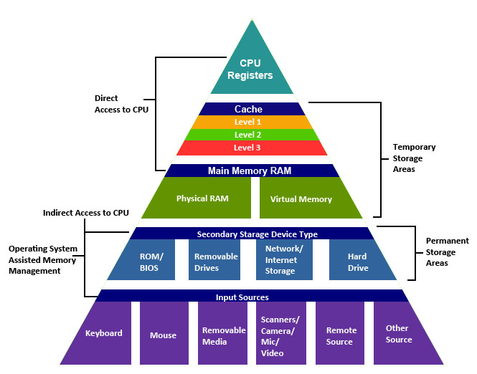
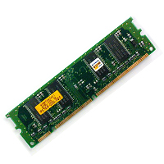
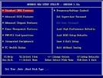
Hierarchical structure of memory
Notes:
Review what we learned in class. This is the hierarchical structure of memory we have been familiar with in theoretical class. In this experiment class we look to the RAM and ROM in the pyramid.

Slide 3
Random Access Memory (RAM)
RAM allows reading and writing of data through the electrical signals.
Volatile, must be provided with constant power supply.
Two types
Static RAM (SRAM)
Dynamic RAM (DRAM) – used in this experiment
Notes:
RAM allows reading and writing, on which the experiment is based.
There are two types, we use the DRAM.

Slide 4
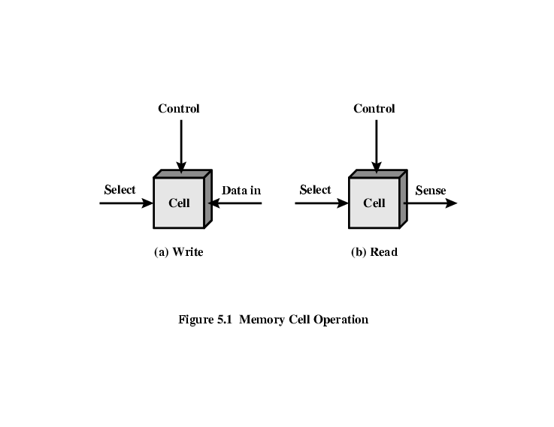
Memory Cell Operation
Three functional terminals
Control read or write
Select cell
Notes:
Totally we use 3 functional terminals to operate with RAM.(1 sentence 1 slide)

Slide 5
Read Only Memory (ROM)
Permanent storage, can not be changed
Nonvolatile, no power is needed
Can read, can not write
Important application:
Microprogramming (discuss later)
Library subroutines
Systems programs (BIOS)
Function tables
Written during manufacture, very expensive
Notes:
Speak of ROM, unlike RAM, it only support reading function in our experiment.

Slide 6
Types of ROM
Read “mostly” than write
Erasable Programmable ROM (EPROM)
Before write, the storage cells must be erased
Erased by UV, and can be repeatedly erased
Electrically Erasable (EEPROM)- used in this experiment
Can be written without erasing prior content
Takes much longer to write than read
Notes:
And there are also 2 types of ROM, EPROM EEPROM, we use the EEPROM.

Slide 7
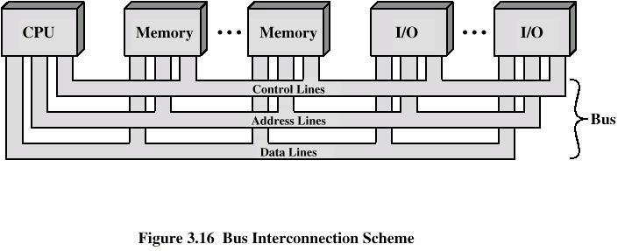
Interconnection for memory
Notes:
Of course there is another indispensabie role – BUS, BUS like blood vessels transports important bit to various devices.

Slide 8
Experiment Preface
Experiment Purpose
(1) Know the read/write operation and feature of RAM and ROM.
(2) Understand the principle of
①Connection between storage and bus;
②Address space mapping of memory;
Experiment content
Design an 8-bit data path to be used in the address-independent ROM and RAM. Implement the function of memory data read and write operations and batch importing in RAM and ROM.

Slide 9
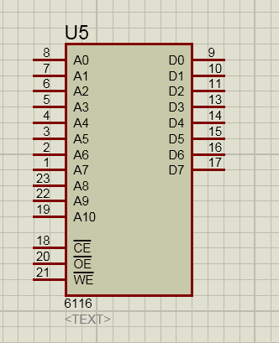
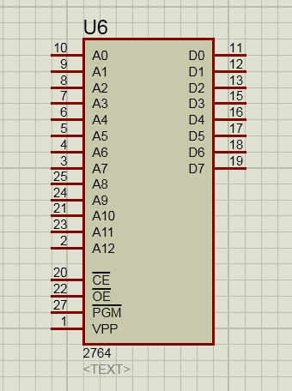
RAM & ROM
RAM（6116）
ROM(2764)
8-bit data output
11-bit Address
Chip Enable
Read Enable
Read Enable
Write Enable
Program pulse(not used)

Slide 10
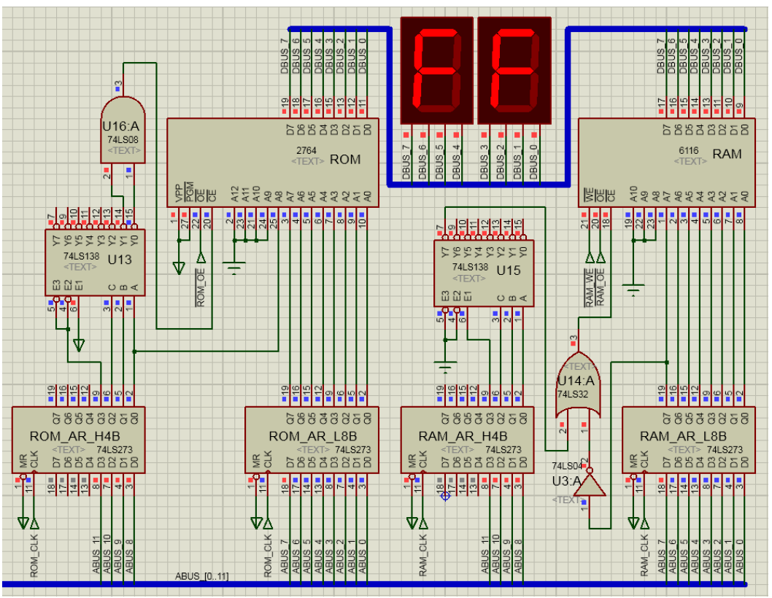
The logical circuit is used
to select RAM or ROM.
3-8 selector
Address
register
Notes:
RAM & ROM
address register
led light
Head 3 bits select storage.

Slide 11
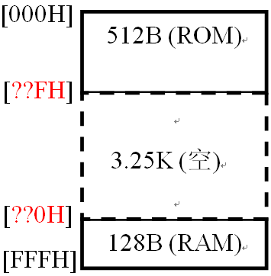
In this experiment we use 512B ROM and 128B RAM.
A11 A10 A9 A8 A7 A6 …. A1 A0
0 0 0 0 0 0 …. 0 0
0 0 0 0 0 0 …. 0 1
…. …. …. …. …. ….
0 0 0 1 1 1 …. 1 0
0 0 0 1 1 1 …. 1 1
…. …. …. …. …. …. …. …. …. ….
1 1 1 1 1 0 …. 0 0
1 1 1 1 1 0 …. 0 1
…. …. …. …. …. ….
1 1 1 1 1 1 …. 1 0
1 1 1 1 1 1 …. 1 1
512B
(ROM)
128B
(RAM)

Slide 12
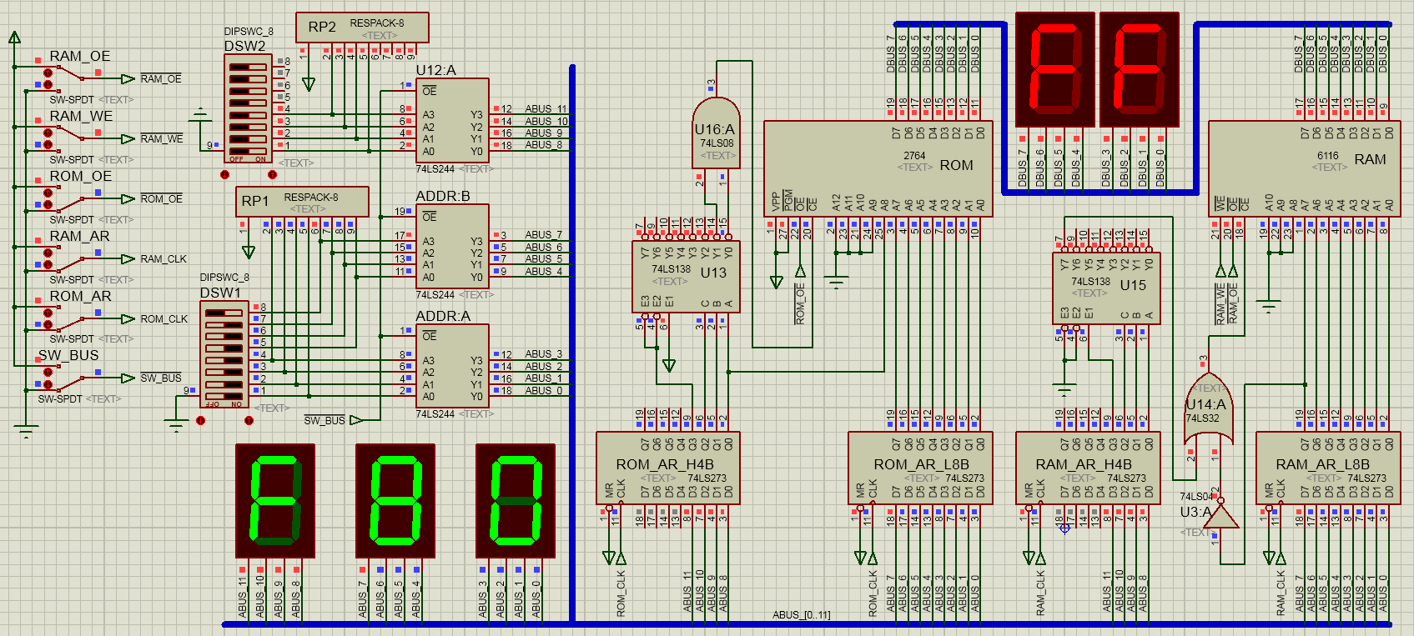
The whole diagram. The right part contains the RAM & ROM modules and the attached logical circuit. The left part functions as the controller. Two led groups seperatively display the address and data.

Slide 13
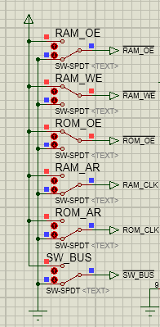
signal | function | enabled voltage level
ROM_CLK | send address to 2764 | rising-edge voltage(manually switch)
RAM_CLK | send address to 6116 | rising-edge voltage(manually switch)
ROM_OE | read-only signal for 2764 | low(manually switch)
RAM_OE | read-only signal for 6116 | low(manually switch)
RAM_WE | write-only signal for 6116 | low(manually switch)
SW_BUS | enable BUS input | low(manually switch)

Slide 14
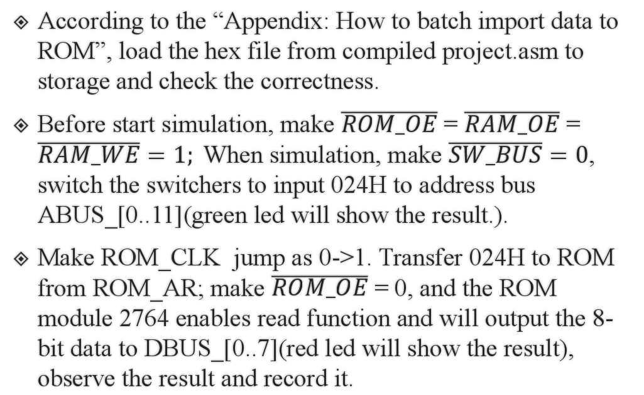
Experiment Steps.1
According to the “Appendix: How to batch import data to ROM”, load the hex file from compiled project.asm to storage and check the correctness.
Before start simulation, make $\overline{ROM_OE}$ = $\overline{RAM_OE}$ = $\overline{RAM_WE}=1;$When simulation, make $\overline{SW_BUS}=0$, switch the switchers to input 024H to address bus ABUS_[0..11](green led will show the result.).
Make ROM_CLK jump as 0->1. Transfer 024H to ROM from ROM_AR; make $\overline{ROM_OE}$ = 0, and the ROM module 2764 enables read function and will output the 8-bit data to DBUS_[0..7](red led will show the result), observe the result and record it.

Slide 15
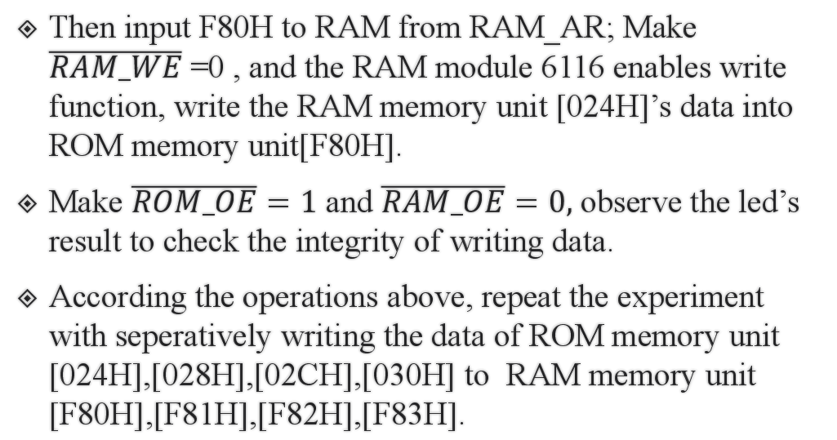
Experiment Steps.2
Then input F80H to RAM from RAM_AR; Make $\overline{RAM_WE}$ =0 , and the RAM module 6116 enables write function, write the RAM memory unit [024H]’s data into ROM memory unit[F80H].
Make $\overline{ROM_OE}=1$ and $\overline{RAM_OE}=0,$ observe the led’s result to check the integrity of writing data.
According the operations above, repeat the experiment with seperatively writing the data of ROM memory unit [024H],[028H],[02CH],[030H] to RAM memory unit [F80H],[F81H],[F82H],[F83H].

Slide 16
Bonus Question
Consider changing the ORG statement to "ORG 0224h", could the data segments that ORG defines be accessed? If not, is the error ocurred in data batch importing? Please modify the ROM address selection circuit to ensure "ORG 0224h" segment can access to data.

Slide 17
Appendix: How to batch import data to ROM
In this experiment it’s the most important key trick to batch import the data into ROM. We will make ROM the role of program storage or data storage in latter experiments.
We will use 8051 assembly instruction to implement the function of batch importing.

Slide 18

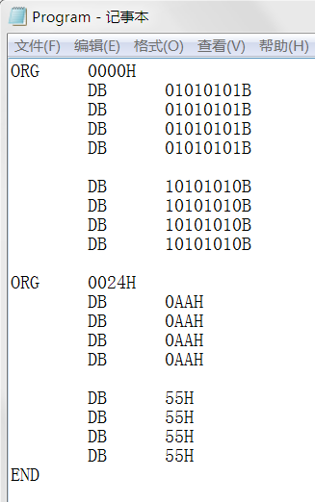
Operation steps
1.new a txt file, input the data following the right side’s format(note adding 0 to the head of hexadecimal), save for Program.txt(file name is case sensitive), and then change .txt to .asm(i.e. Program.asm).
2.ORG XXXXH specifies the head address of data array. It ends with END instruction. Before END, you can add multiple ORG segment.
PS:if you need to clear data, you need write an ORG statement of all 000Hs to overwrite.

Slide 19
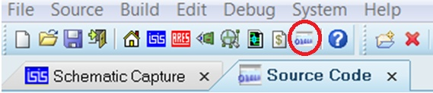
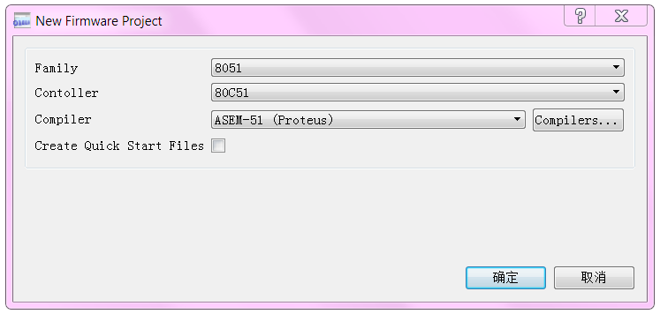
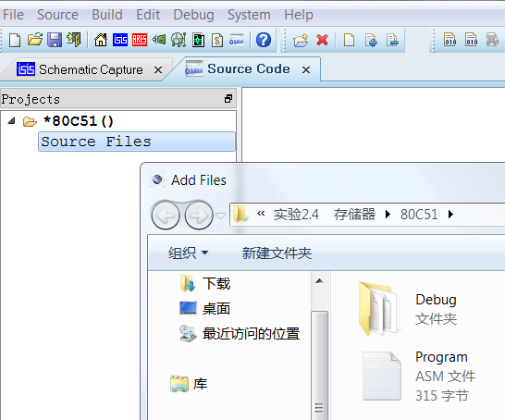
Open “source code” panel :
Find Source->Create Project in menu bar:
In the popup window choose family and controller like right side’s image.
Make sure not select Create Quick Start Files.
The tab will show up the *80C51() project, right click “Source Files” and “Add files” to add the .asm file you just edited.

Slide 20
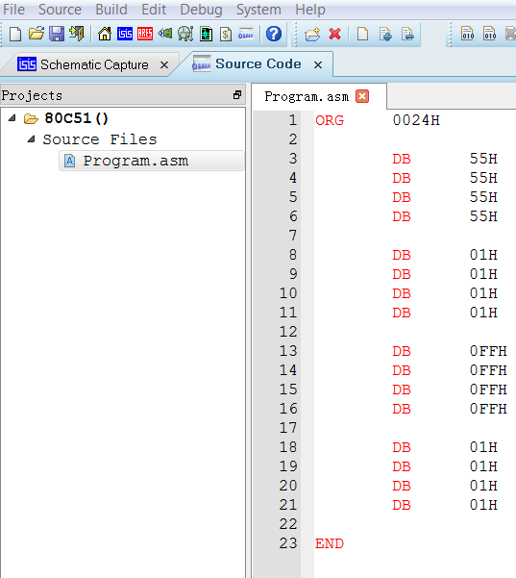
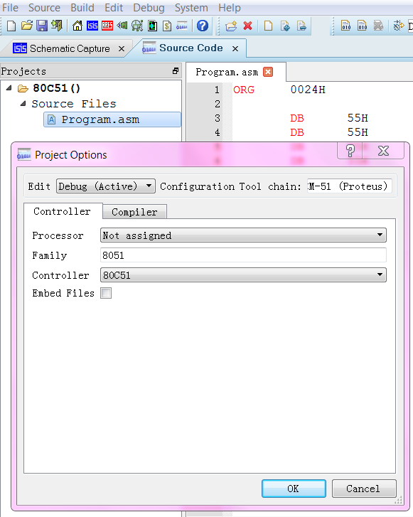
Open the asm by double-clicking it. If you want to change the file you can first remove it and then add the file you’d like to change.
The new asm file need to be compiled, right click it and choose Project Settings, choose 80C51 in the controller option, Deselect Embed Files. Click “OK” and right click it again and Build Project.

Slide 21
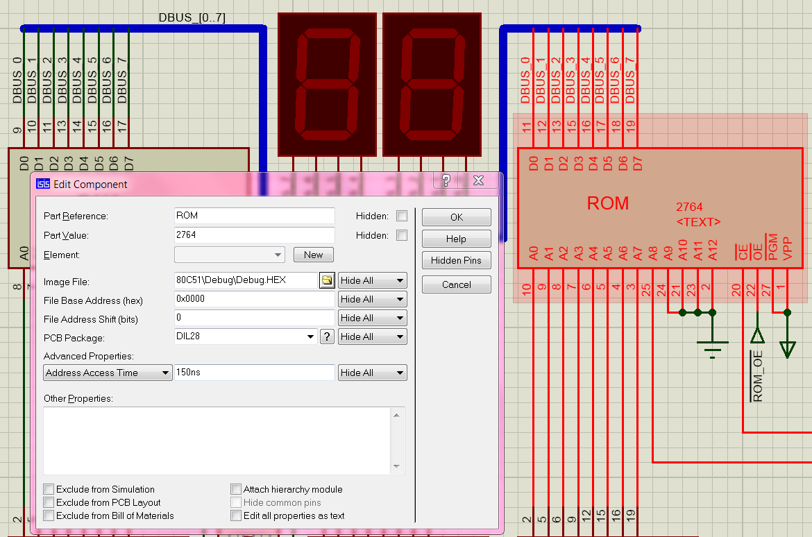
In the diagram tab, double-click ROM module and choose the .hex(from the compiling) in the Image File.(Recommend to change hex file name in case of overwriting by other asm file.)

Slide 22
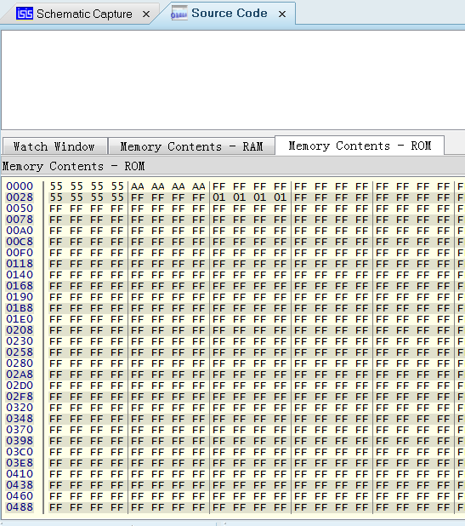
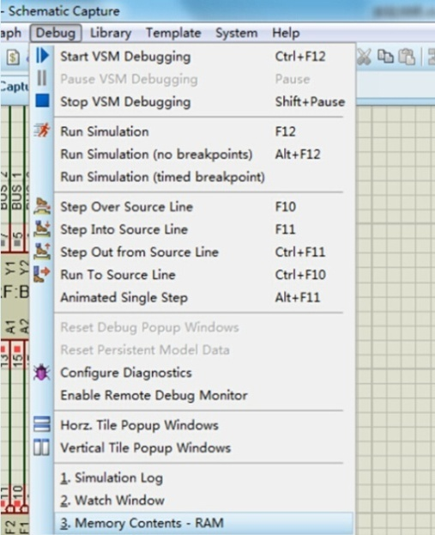
Start simulation and then click “pause” button, choose “Debug” in the menu bar and check the memory contents – RAM or ROM.
Finally you can find the memory contains the data you just import.

Slide 23
Some useful tips
What’s the .hex file?
.hex file in general saves the machine code and is compiled from .asm or other program file.
Differences between RAM & ROM
RAM can read and write. ROM only support read.
RAM loses data after simulation. ROM preserves data.
Why do the experiment?
Not just review the theory. RAM & ROM is important in the microcontroller experiment.
Others?

Slide 24
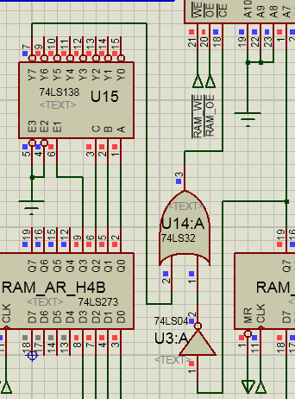
Common Questions
The requirement of ROM and RAM’s address.
the addresses in the experimental steps are mapped to the address in the module. RAM’s address must be set from [F80H] to [FFFH],
3-8 selector
the output must be 0 for
enabling the RAM

Slide 25
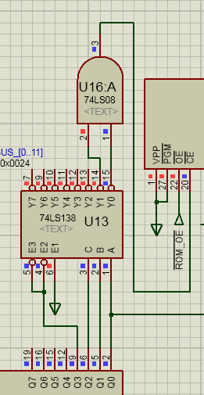
ROM’s address must be set from [000H] to [1FFH].
the and gate must output 0
CBA could be “000” or “001”

Slide 26
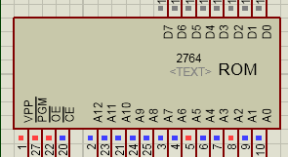
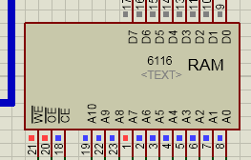
You must check to the mapped address in A0-Ax

